Slide 1
AVL TREE IMPLEMENTATION
RNS INSTITUTE OF TECHNOLOGY
BENGALURU - 98
DEPARTMENT OF INFORMATION SCIENCE & ENGINEERING
ADA Mini Project Work Presentation
Candidate Names
HEMANTH T : 1RN22IS050
JAVADEVA K M: 1RN22IS056
JENU J HEGDE : 1RN22IS057
Faculty Incharge
Dr. Sunitha
Asst. Prof
Dept of ISE, RNSIT

Slide 2
AGENDA
Abstract
Introduction
Algorithm
System Requirements
Implementation/Code
Discussion of Results-Sample input and Output
Time Complexity
Real time Applications
Conclusion and Future Enhancements
Q & A
IV Semester, Department of ISE, RNSIT
2023 - 2024

Slide 3
ABSTRACT
This mini project implements an AVL tree in C, a self-balancing binary search tree known for efficient search operations. It covers AVL tree basics—insertion, deletion, and rotations for balancing. Performance evaluations highlight AVL trees' efficiency compared to non-balanced structures like binary search trees (BSTs), especially in dynamic datasets. Practical applications demonstrate AVL trees' effectiveness in maintaining consistent search performance. This project offers practical insights into AVL tree algorithms and their efficiency in real-world applications.
IV Semester, Department of ISE, RNSIT
2023 - 2024

Slide 4
INTRODUCTION
Give Brief introduction about your project
An AVL tree defined as a self-balancing Binary Search Tree (BST) where the difference between heights of left and right subtrees for any node cannot be more than one.
The difference between the heights of the left subtree and the right subtree for any node is known as the balance factor of the node.
The AVL tree is named after its inventors, Georgy Adelson-Velsky and Evgenii Landis, who published it in their 1962 paper “An algorithm for the organization of information”.
AVL Rotations
We perform rotation in AVL tree only in case if Balance Factor is other than -1, 0, and 1. There are basically four types of rotations which are as follows:
L rotation: Inserted node is in the left subtree of left subtree of A
R rotation : Inserted node is in the right subtree of right subtree of A
L R rotation : Inserted node is in the right subtree of left subtree of A
R L rotation : Inserted node is in the left subtree of right subtree of A
IV Semester, Department of ISE, RNSIT
2023 - 2024

Slide 5
Algorithm
Give the Proper Algorithm
Insert Node:
Perform standard BST insertion.
Add the new node to the correct position based on BST rules.
Update Heights:
Update the height of the ancestor nodes, starting from the newly inserted node up to the root.
Balance Factor Check:
Balance Factor=Height of Left Subtree−Height of Right Subtree
If the balance factor is within the range [-1, 0, 1], the subtree is balanced.
Rotation to Balance:
If the balance factor is not within the range, apply rotations to balance the tree:
LL Case (Left Left): Perform a right rotation.
RR Case (Right Right): Perform a left rotation.
LR Case (Left Right): Perform a left rotation on the left child, followed by a right rotation.
RL Case (Right Left): Perform a right rotation on the right child, followed by a left rotation
IV Semester, Department of ISE, RNSIT
2023-2024

Slide 6
System Requirements
Programming language :Python
Version: Python 3.6 or later is recommended.
Installation: Ensure Python is installed and added to your system’s PATH.
Streamlit:
Version: 1.0 or later.
Installation: Install via pip
pip install streamlit
Graphviz:
Version: Latest stable version.
Installation: Install the Python package via pip and also the Graphviz system package
pip install graphviz
IV Semester, Department of ISE, RNSIT
2023-24

Slide 7
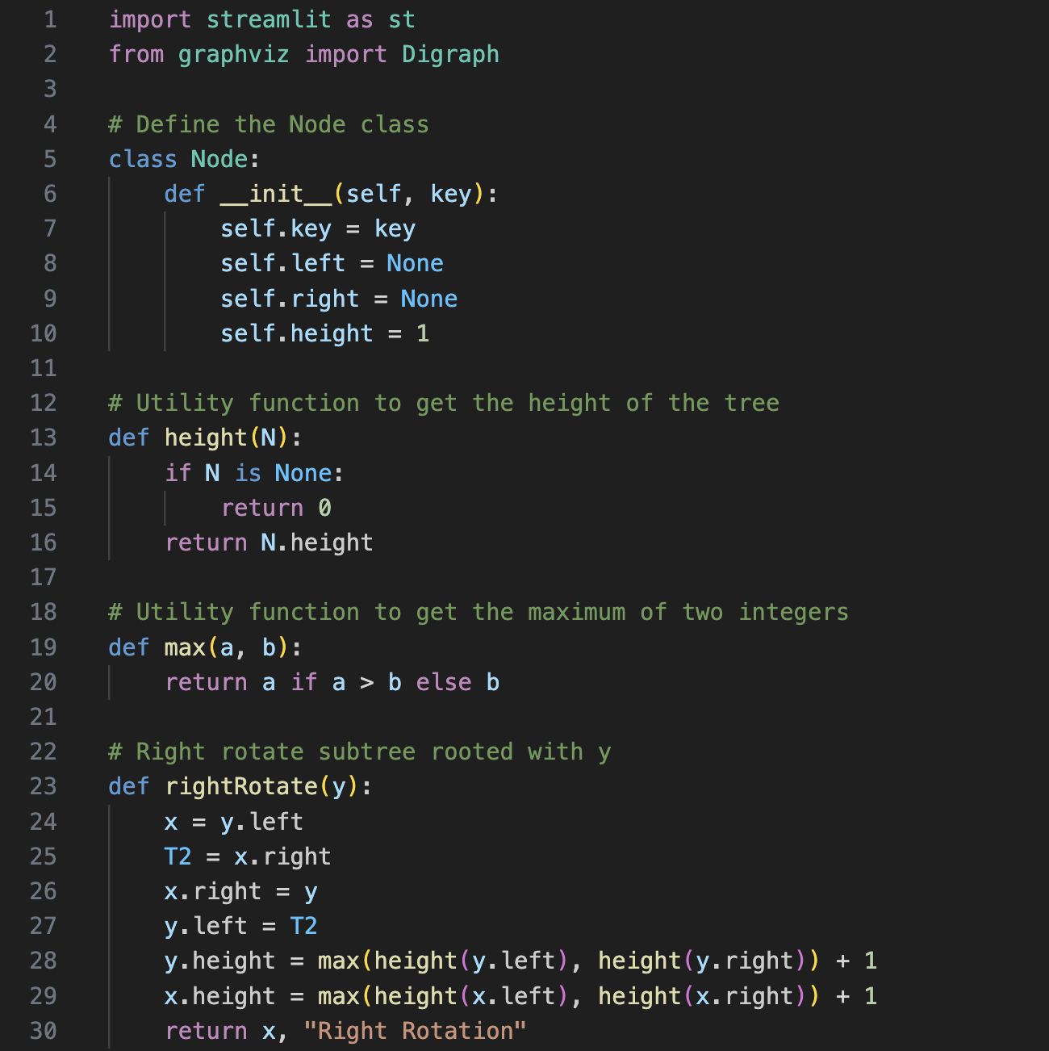
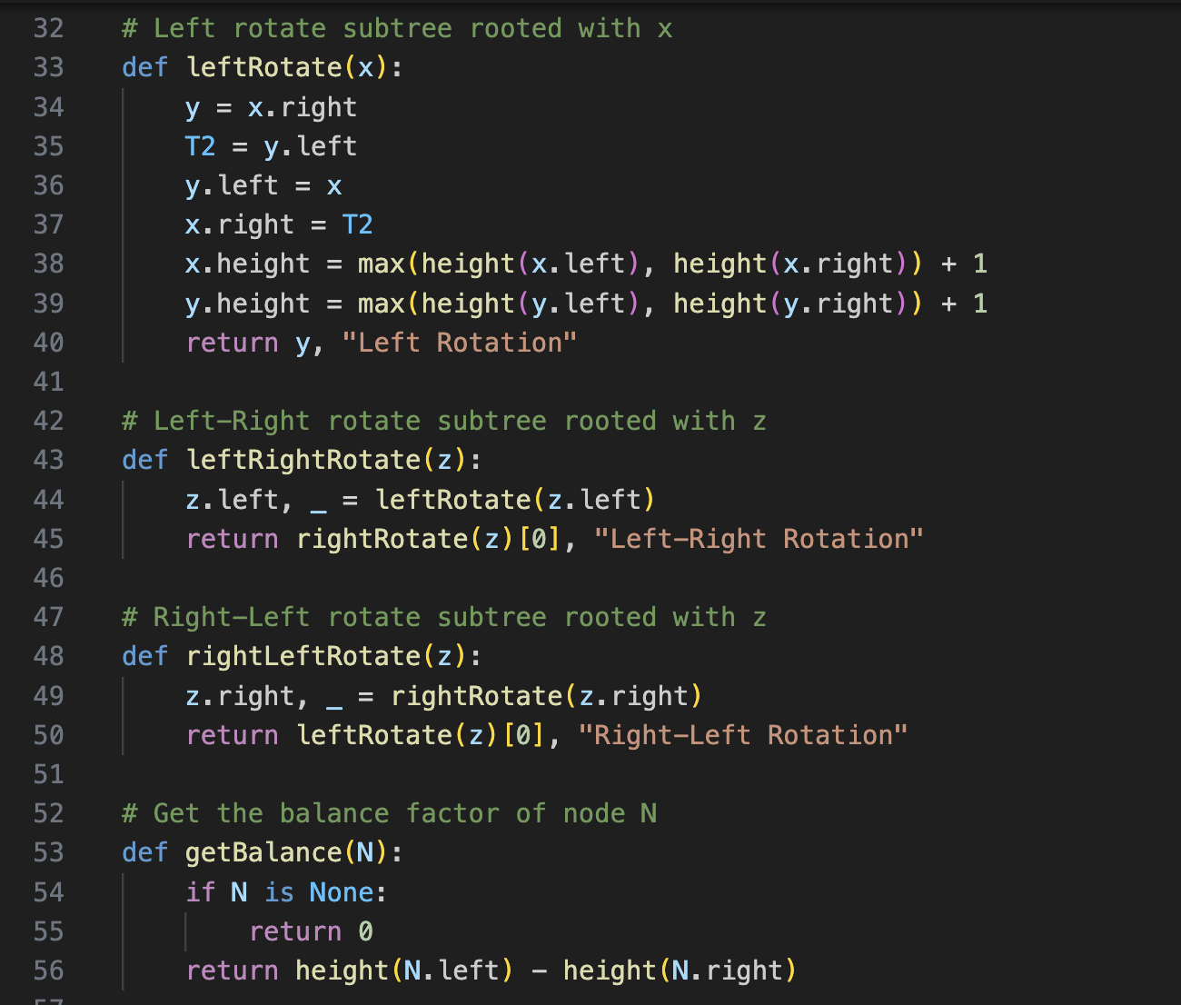
Implementation / Coding
Python Language Is Used
IV Semester, Department of ISE, RNSIT
2023 - 2024

Slide 8
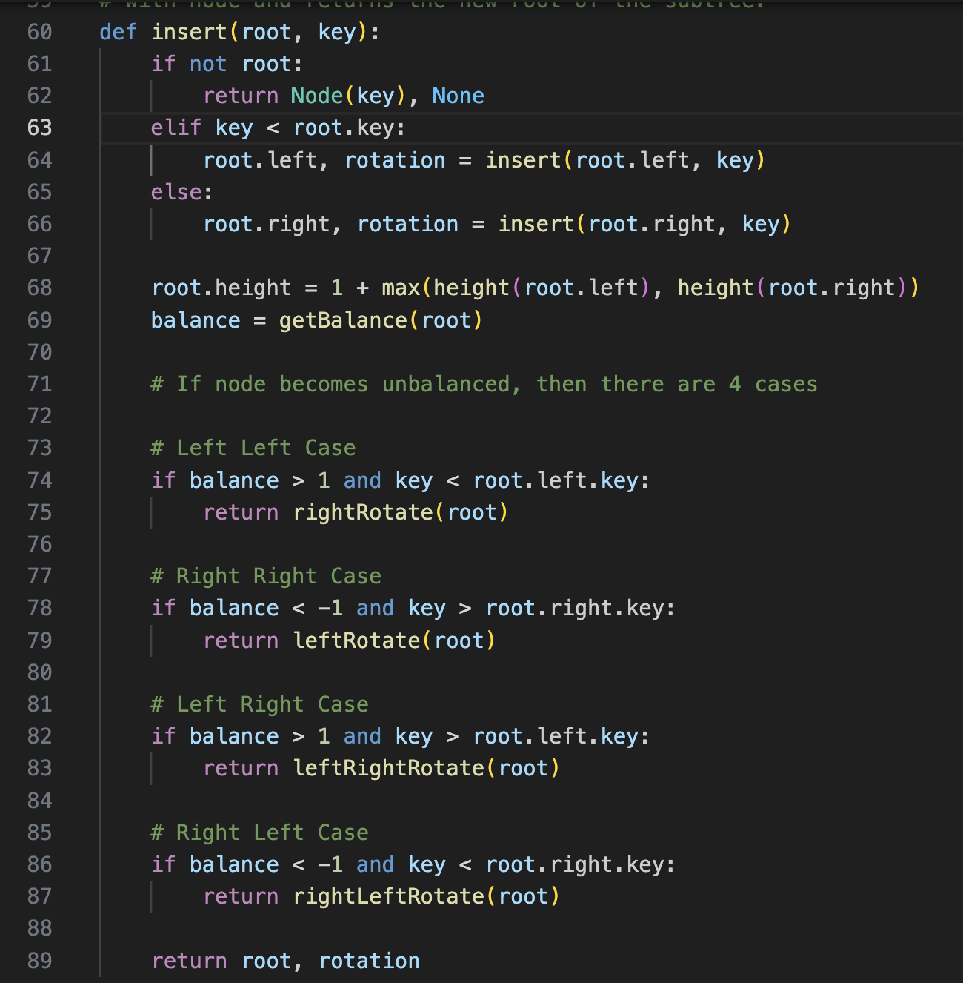
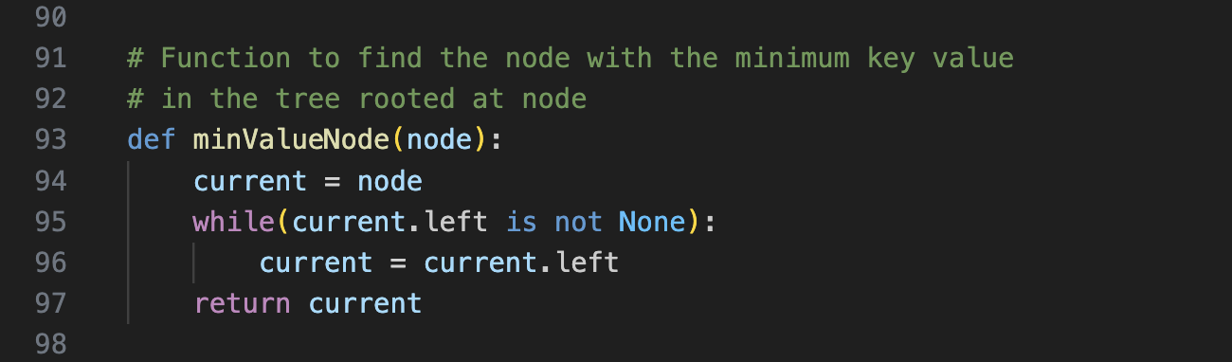
Implementation / Coding
IV Semester, Department of ISE, RNSIT
2023 - 2024

Slide 9
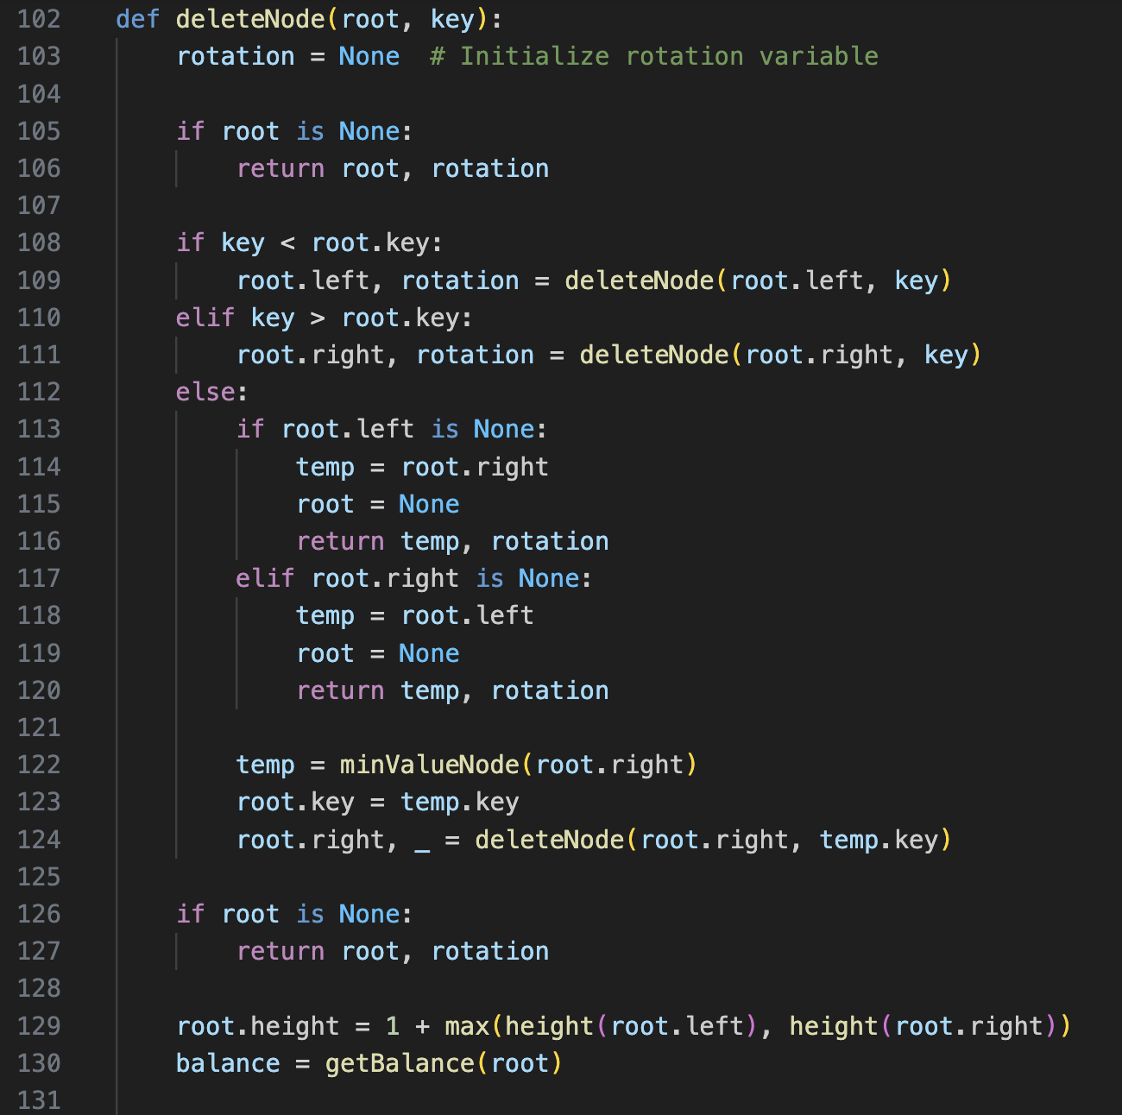
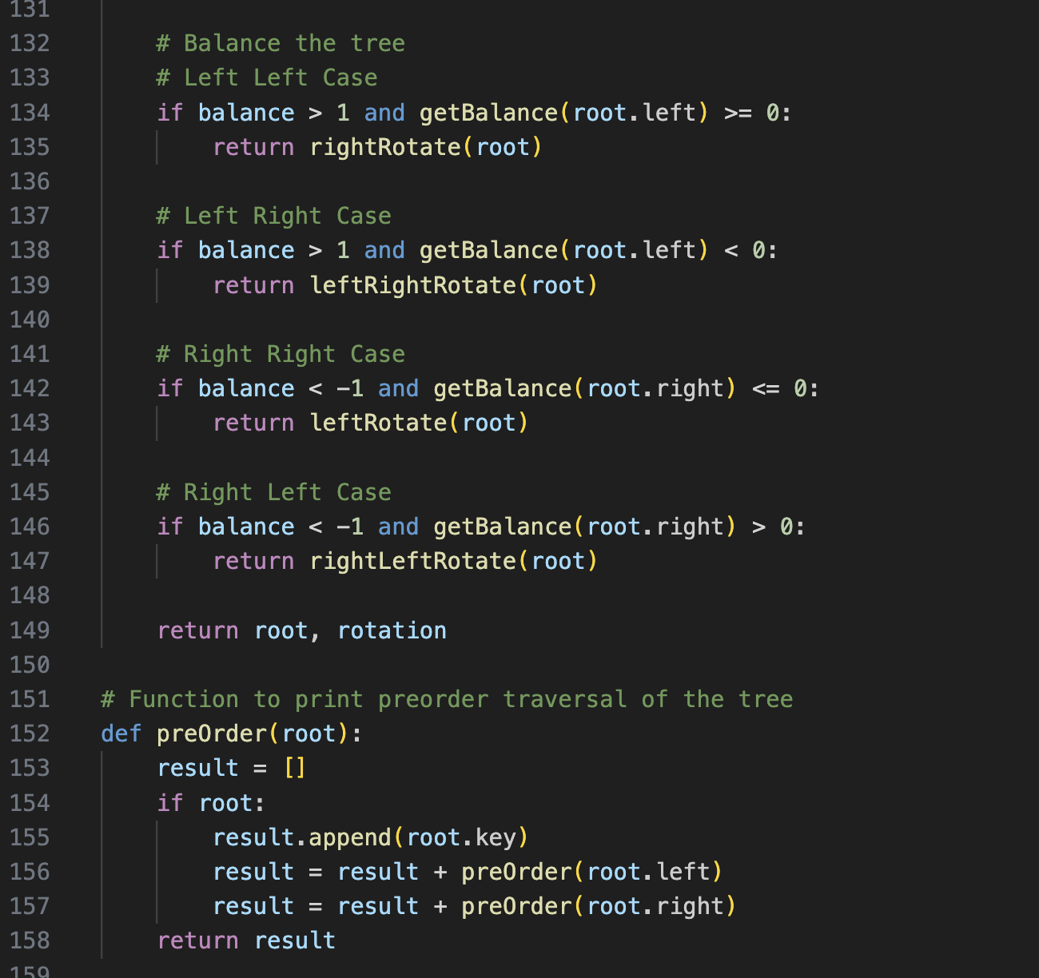
Implementation / Coding
IV Semester, Department of ISE, RNSIT
2023 - 2024

Slide 10
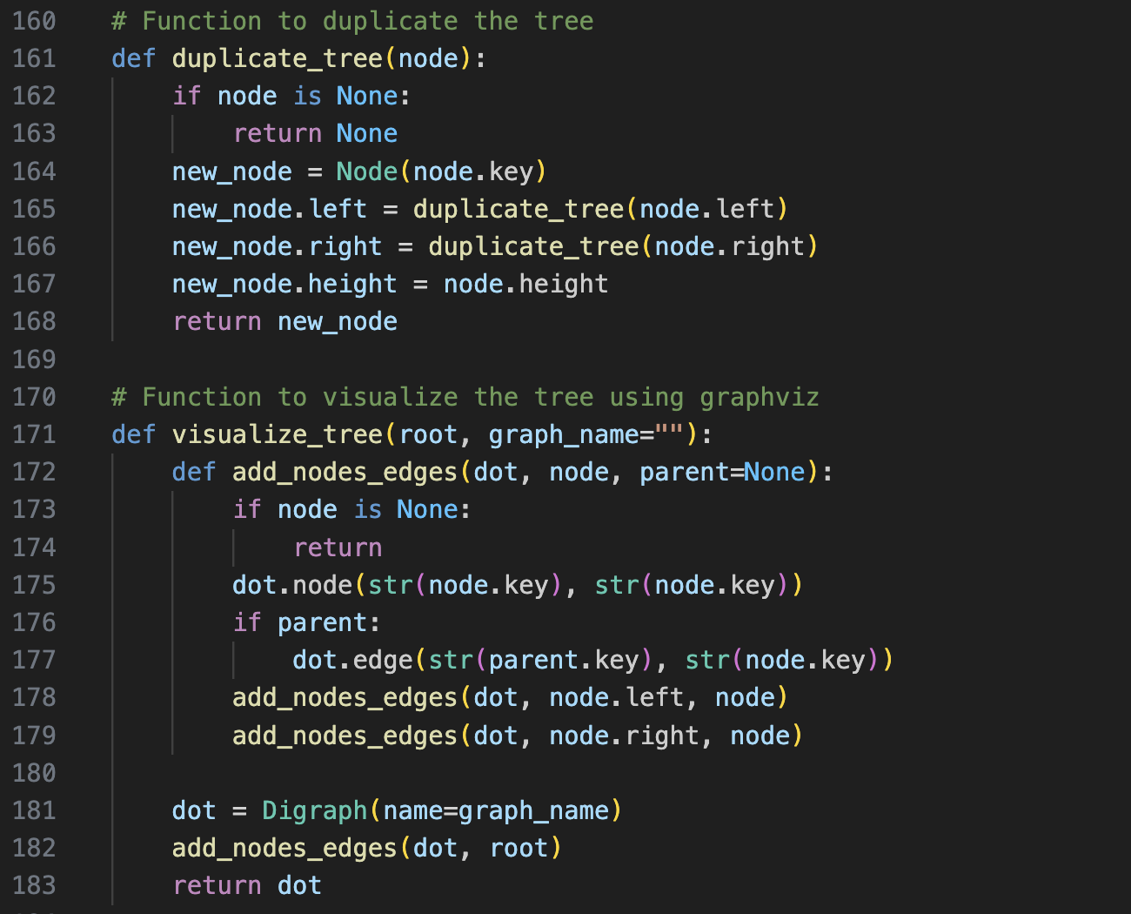
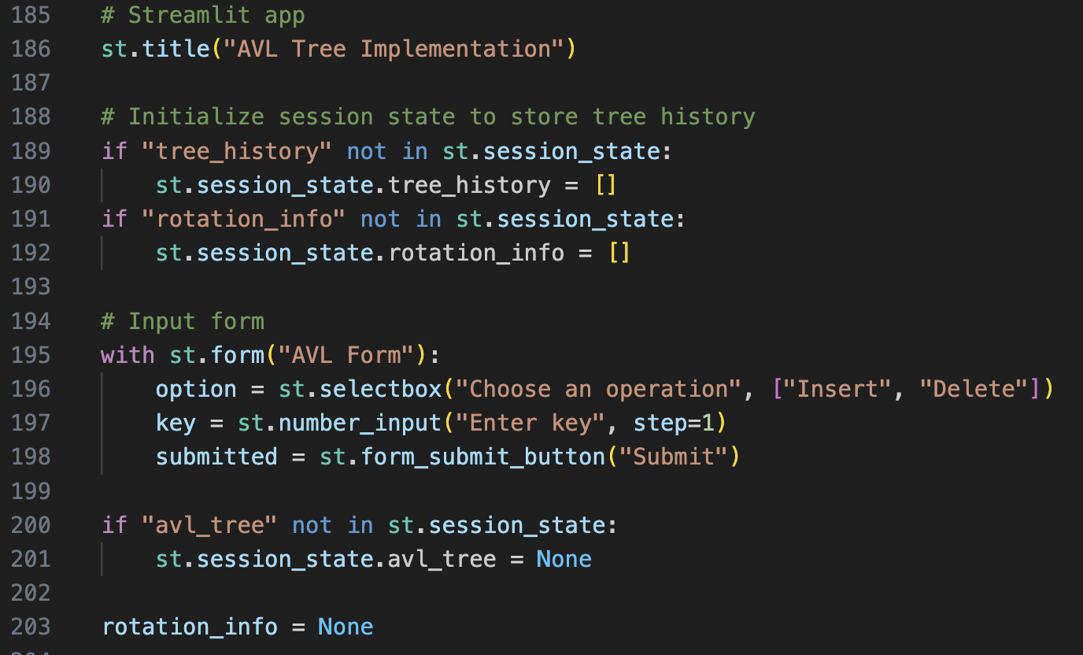
Implementation / Coding

Slide 11
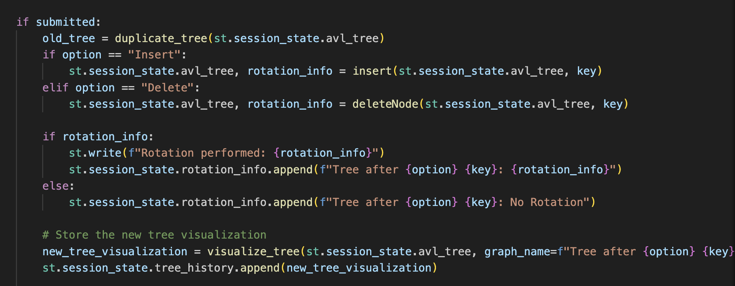
Implementation / Coding

Slide 12
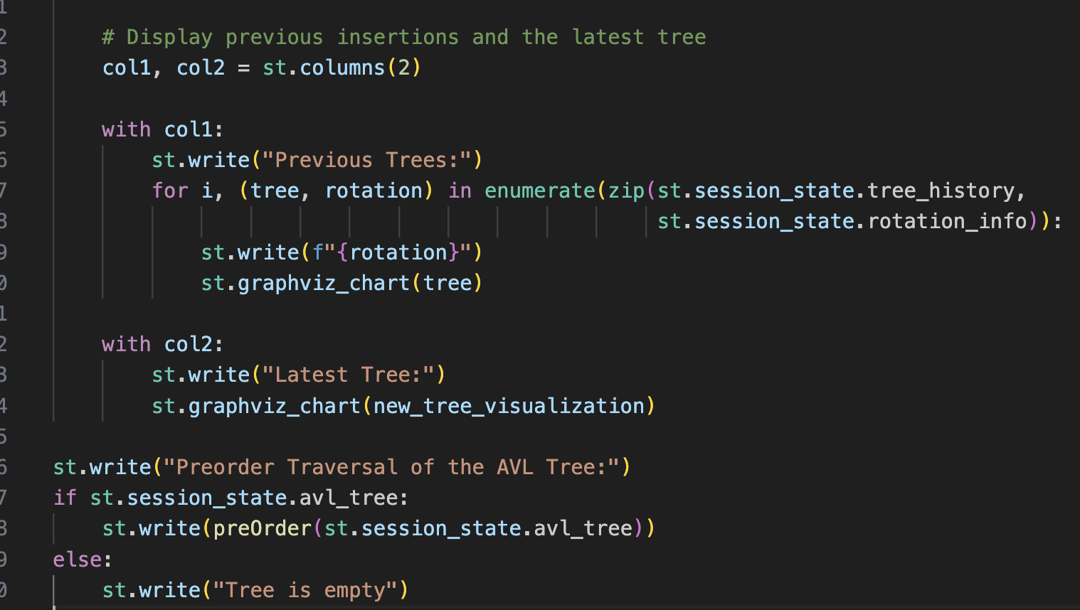
Implementation / Coding

Slide 13
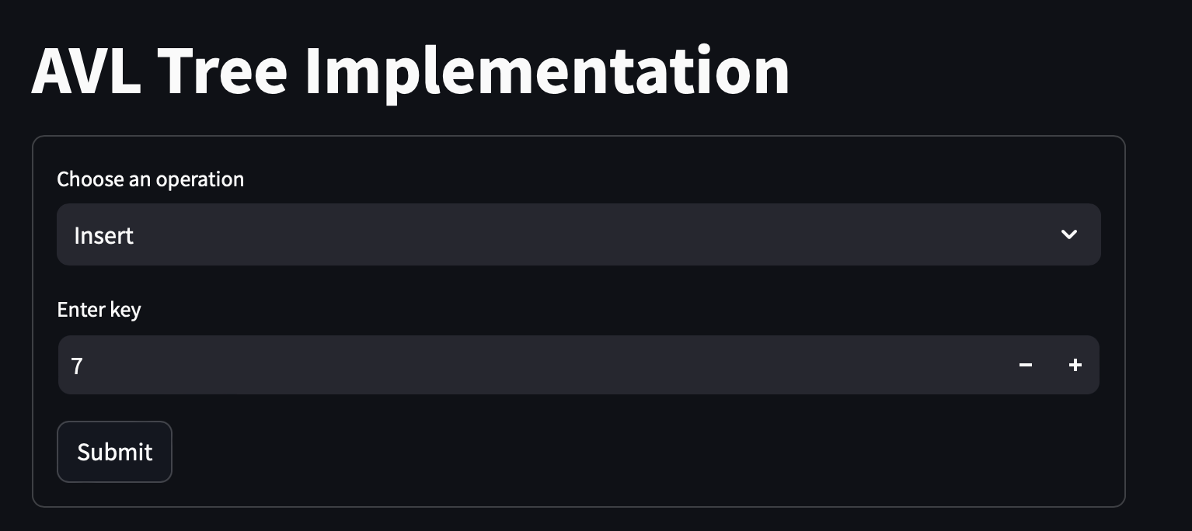
Discussion of Results
IV Semester, Department of ISE, RNSIT
2023 - 2024

Slide 14
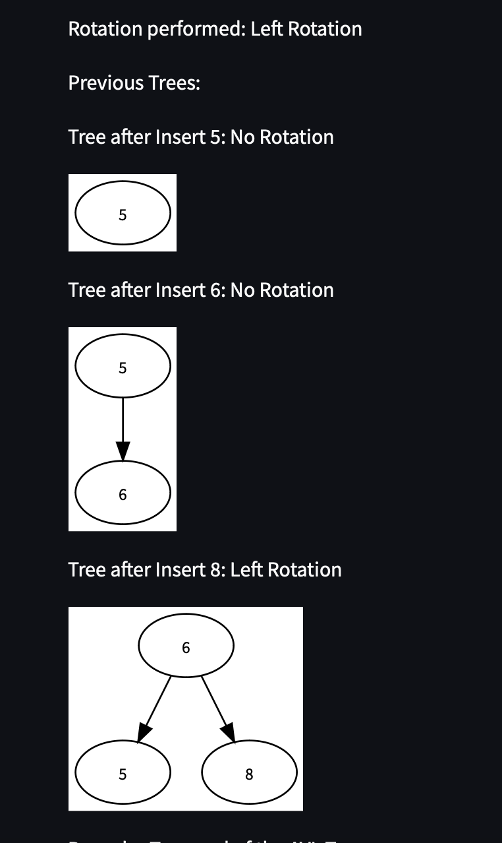
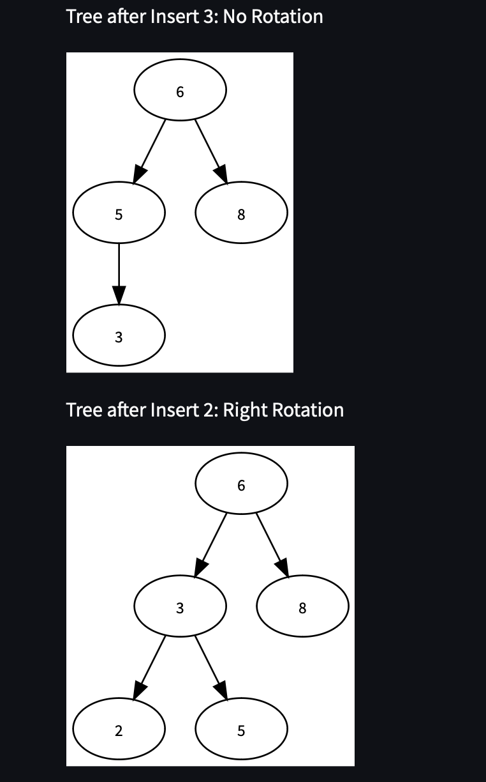
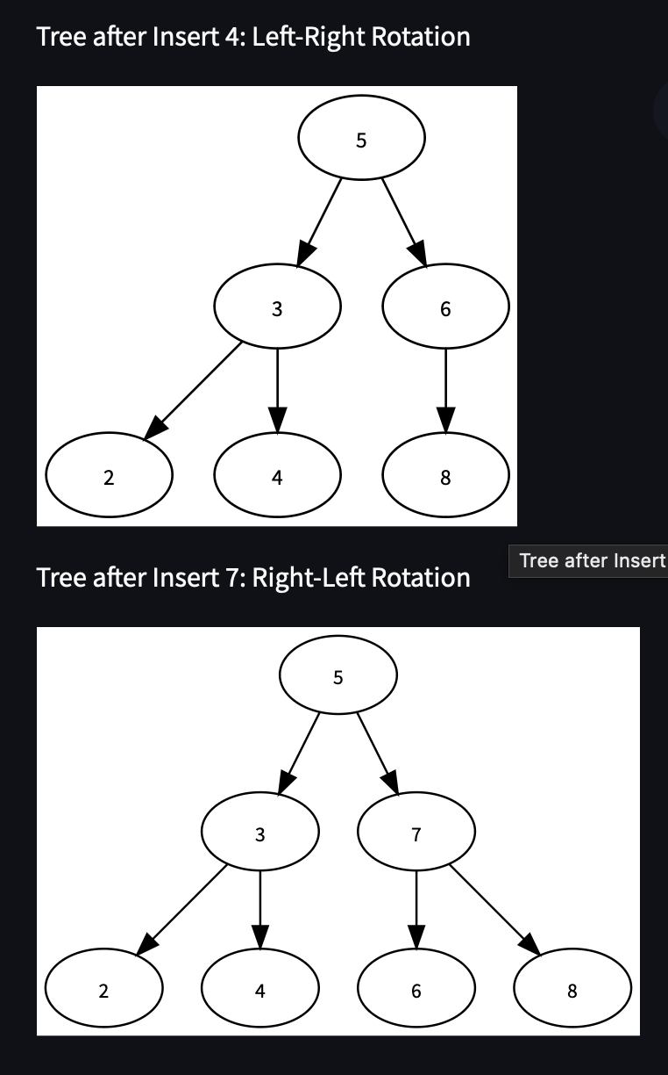
Discussion of Results

Slide 15
Time Complexity
Insertion:
Time Complexity: O(logn)
Explanation: Insertion in an AVL tree involves finding the correct location for the new node, which takes O(logn)time due to the tree's balanced nature. After insertion, rebalancing the tree (if necessary) also takes O(logn)time because the height of the tree is always O(logn).
Deletion:
Time Complexity: O(logn)
Explanation: Similar to insertion, deleting a node involves locating it (which is O(logn))and rebalancing the tree (if needed) is also O(logn). The height of the AVL tree ensures that rebalancing operations are efficient.
Comparison with Other Tree Structures
Binary Search Tree (BST):
Average Time Complexity: O(logn) for insertion, deletion, and search operations, but it can degrade to O(n)in the worst case (e.g., if the tree becomes unbalanced and resembles a linked list).
AVL Tree: Maintains strict balance, ensuring O(logn)time complexity for all operations in the worst case.
IV Semester, Department of ISE, RNSIT
2023 - 2024

Slide 16
Applications
Database Indexing: AVL trees are used to maintain indexes in databases. They help in efficiently searching, inserting, and deleting records, ensuring quick access to data.
Memory Management: Operating systems use AVL trees to manage free memory blocks. The balanced nature of AVL trees helps in quick allocation and deallocation of memory.
File Systems: Some file systems use AVL trees to keep track of file locations, ensuring efficient file retrieval and storage operations.
Job Scheduling Systems: AVL trees are used in job scheduling systems to manage and prioritize tasks efficiently. They ensure that the highest priority tasks are always accessible for execution.
IV Semester, Department of ISE, RNSIT
2023 - 2024

Slide 17
CONCLUSIONS
the implementation of an AVL tree enhances the efficiency of binary search trees by ensuring balanced height, thereby guaranteeing O(log n) time complexity for insertion, deletion, and search operations. By maintaining the balance through rotations after every modification, AVL trees offer improved performance compared to unbalanced binary search trees, making them suitable for applications requiring frequent and dynamic updates. The complexity of implementing rotations and balancing, while initially intricate, results in a robust data structure that optimizes operations and provides consistent performance, showcasing the trade-off between complexity and efficiency in advanced data structures.

Slide 18
Future Enhancements
Adaptive Balancing: Integrating machine learning techniques to adaptively balance the tree based on usage patterns.
Parallel Processing: Enhancing AVL trees for concurrent operations in multi-threaded environments.
Space Optimization: Reducing memory overhead by optimizing node structure and balance information storage.
Hybrid Structures: Combining AVL trees with other data structures like hash tables for specialized applications.
IV Semester, Department of ISE, RNSIT
2021 - 2022

Slide 19
THANK YOU
IV Semester, Department of ISE, RNSIT
2021 - 2022

